Slide 1
How corporations use AI to manipulate human behaviour
By: P. A. Mitin, ИУ6-24Б
Supervisor: E. P. Gurina

Slide 2
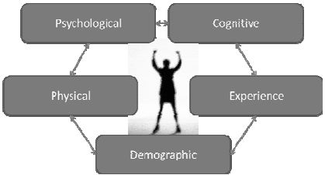
Prediction of user’s characteristics

Slide 3
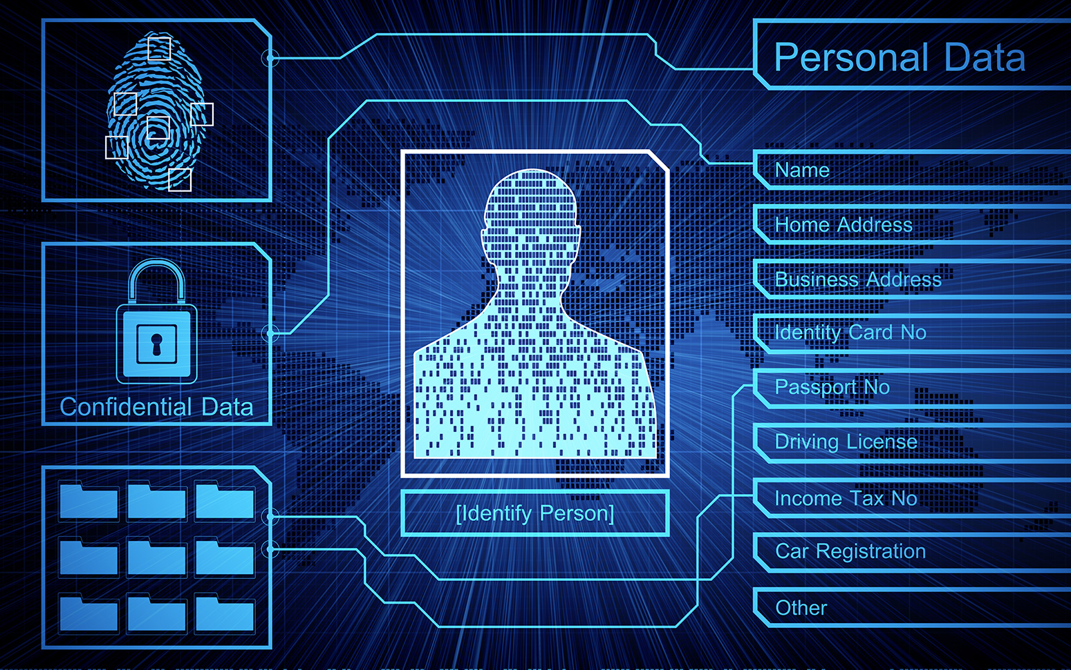
Ways of AI’s exploitation of personal data

Slide 4

Base principle of manipulations

Slide 5




Examples (intrigues, scandals, investigations)

Slide 6
Thank you for your attention!
© BMSTU, 2023

